Slide 1

Note: The data and information in this document is reflective of a hypothetical situation and client. This document is to be used for KPMG Virtual Internship purposes only.
Sprocket Central Pty Ltd
Data analytics approach
Alejandro Thompson Data Analyst KPMG

Slide 2
Note: The data and information in this document is reflective of a hypothetical situation and client. This document is to be used for KPMG Virtual Internship purposes only.
Agenda
Introduction
Data Exploration
Model Development
Interpretation

Slide 3
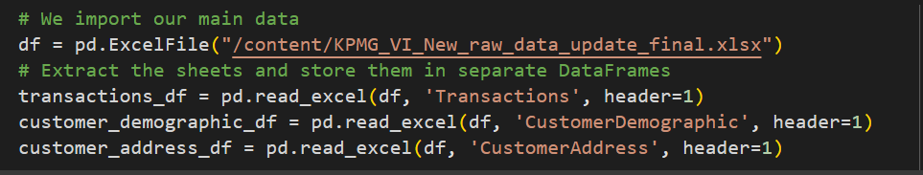
Note: The data and information in this document is reflective of a hypothetical situation and client. This document is to be used for KPMG Virtual Internship purposes only.
Introduction
Customer reviews of Sprocket Central Pty Ltd.
We have 3 datasets with the Transaction data and the data of our customers with their respective locations. In this analysis we will obtain the analysis by doing a total cleaning of the data, we will fill in the data that we can and we will eliminate the data that is not complete in order to formulate competitive strategies.

Slide 4
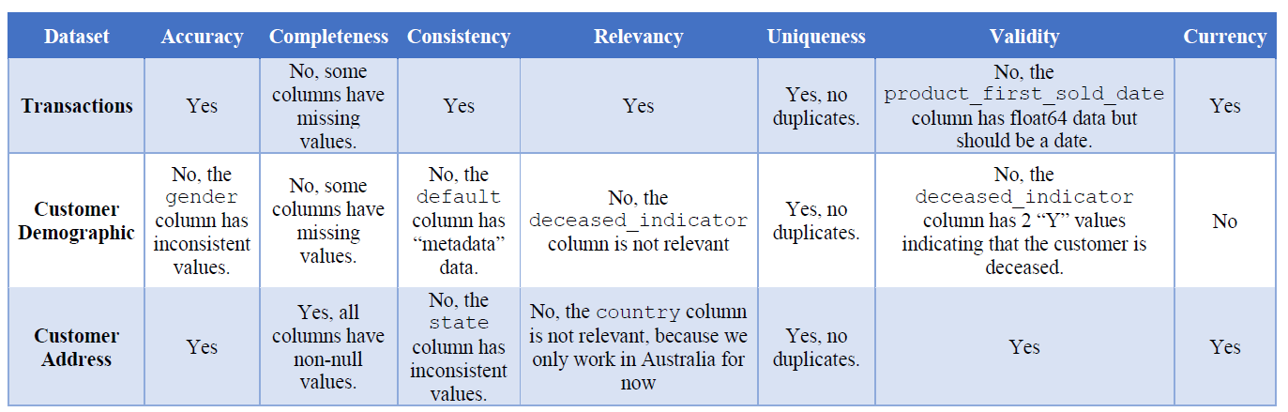
Note: The data and information in this document is reflective of a hypothetical situation and client. This document is to be used for KPMG Virtual Internship purposes only.
Data Exploration
Data cleaning
After exploring the 3 datasets we can say that we have many changes to make, but nothing impossible, we will standardize certain columns and eliminate incomplete data. Given that we have 20,000 records we have a good amount to extract the required information.

Slide 5
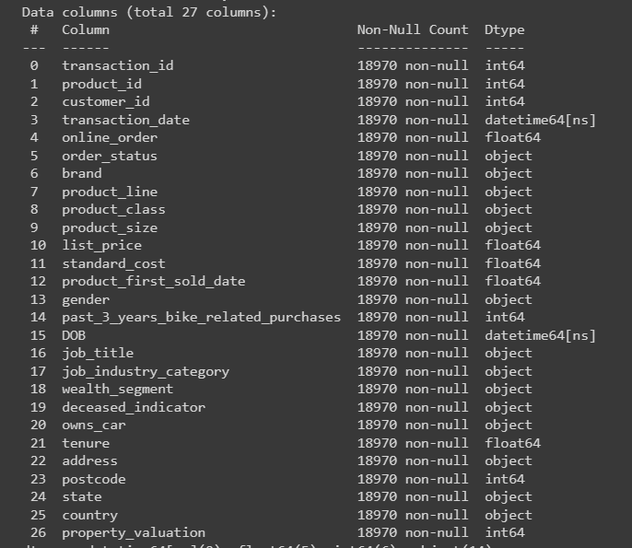
Note: The data and information in this document is reflective of a hypothetical situation and client. This document is to be used for KPMG Virtual Internship purposes only.
Model Development
Merge and Let`s Go!
We avoid eliminating a lot of data, so in the "Job" columns we fill in "Other". We capitalized some columns. We improved the spelling. We eliminated customer records without a date of birth so that we can do an age analysis. We normalized the status data, but we will use the postcode more. Still, the data is enough to do a good analysis so we will start with this merged file with all the clean and relevant data.

Slide 6
Note: The data and information in this document is reflective of a hypothetical situation and client. This document is to be used for KPMG Virtual Internship purposes only.
Interpretation
With the data we have we could apply machine learning techniques that are more accurate. But with just the analysis we did we will extract insights just as relevant.
The most loyal customers live in NWC and Victoria
Women and men from 40 to 50 years old are the most loyal customers.
There is a trend between the ages of 25 to 39 among men and women who consume a lot of the products.
The industries we are most sought after are manufacturing, financial services, healthcare, and others that we need to validate.
The brand most sought after by our consumers is Solex.
The Mass Customer segment is the segment we need to follow up on, both those who have a car and those who don’t.
We also need to focus on those who have a car and those who do not.
We should focus on the people who have a property valuation between 6 to 10
According to our analysis we can focus on approximately 200 new consumers

Slide 7
Note: The data and information in this document is reflective of a hypothetical situation and client. This document is to be used for KPMG Virtual Internship purposes only.
Appendix

Slide 8
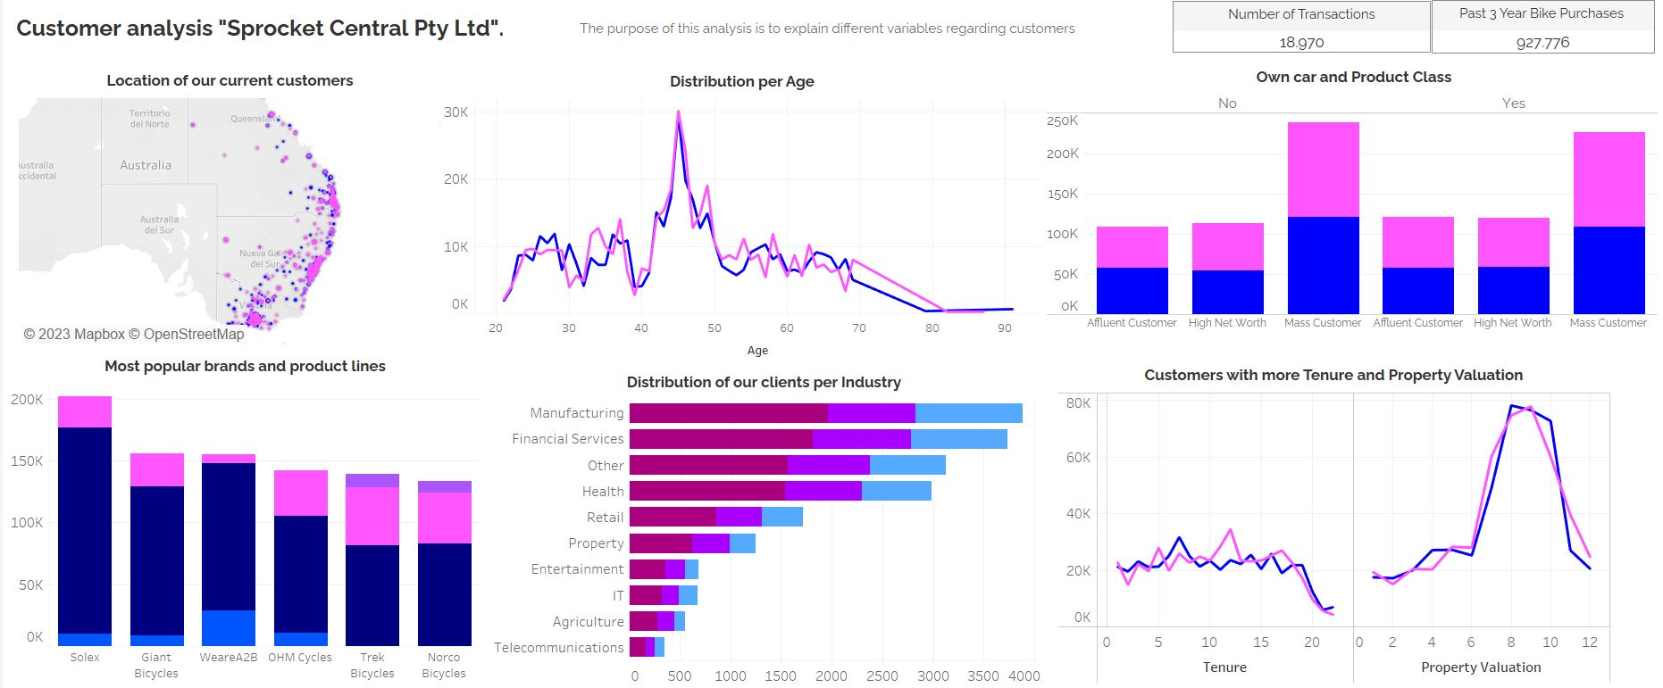
Note: The data and information in this document is reflective of a hypothetical situation and client. This document is to be used for KPMG Virtual Internship purposes only.
Appendix
That was our analysis to find out more please analyze the dashboard.
https://public.tableau.com/views/Forage-KPMG-AnalysisCustomers/Dashboard1?:language=es-ES&publish=yes&:display_count=n&:origin=viz_share_link
Thanks!

